Slide 1
Smart City Reporting System
Created by Nir Solooki, Ephraim Crystal, Meir Jacobs, and Max Friedman

Slide 2
We created a Smart City Reporting System, a system in which users can report and search for issues in their city, and employees can log in to a portal where they can take on issues and update data. We made the backend with AWS (in particular, CloudFormation, API Gateway, Lambda, RDS, S3, Secrets Manager, and CloudWatch). We used Spring Boot to create a web application built on our AWS system. Finally, we used Docker to create an executable file that anyone can easily run on their computer.

Slide 3
We started out with using AWS to create a way to store data:
A relational database with tables for storing current issue data, logged data, and employee data
An S3 Bucket for storing user-submitted images, sorted into folders grouped by report ID
The database links to these images

Slide 4
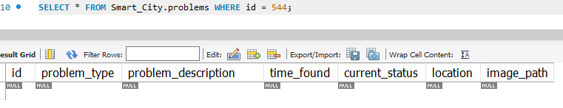
Life cycle of a problem
A problem is submitted:
Then an employee decides to deal with the problem:
Finally, the employee completes the problem and it is subsequently deleted from the table:

Slide 5
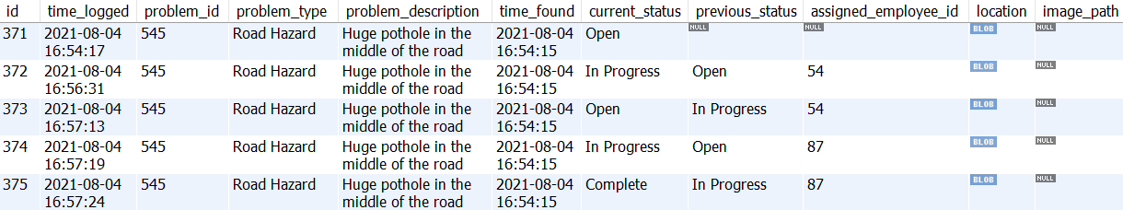
A table to log what has happened with each problem

Slide 6
We created Lambda functions for writing to and reading from our database:
AddProblem, UpdateProblem, ReadProblem, DeleteProblem, LogProblem
AddEmployee, DeleteEmployee
Each of these lambdas:
Validates their input
Connects to the database using credentials found in AWS Secrets Manager
AWS Secrets Manager stores encrypted key-value pairs. We used it to store the information needed to connect to the database, since our system is deployed by CloudFormation. The database hostname and password will thus be different each deployment.
Writes to or reads from a table in the database

Slide 7
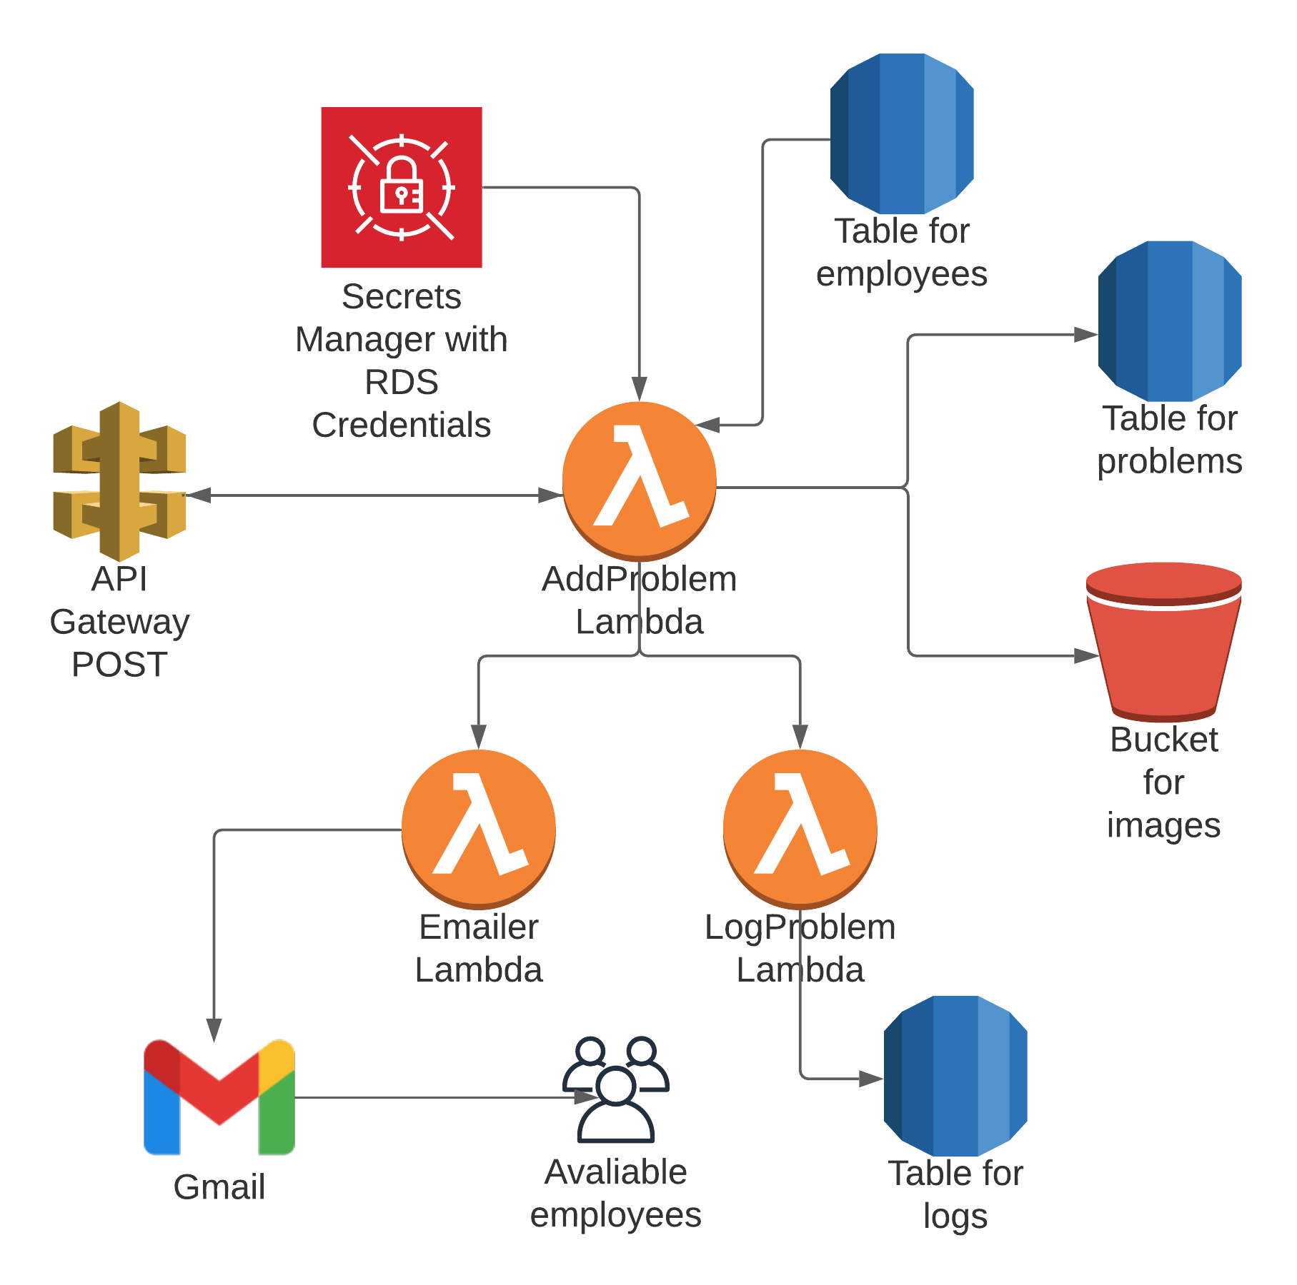
AddProblem

Slide 8
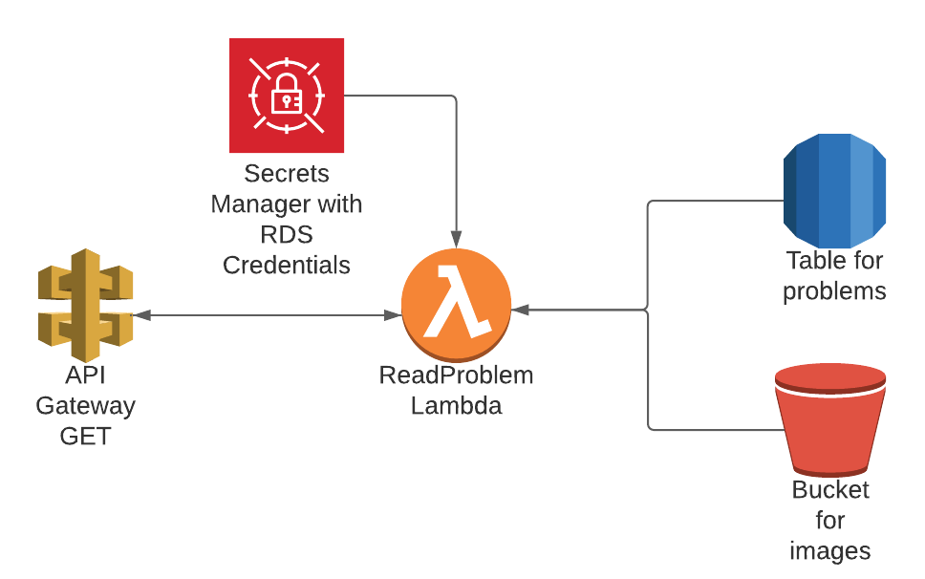
ReadProblem

Slide 9
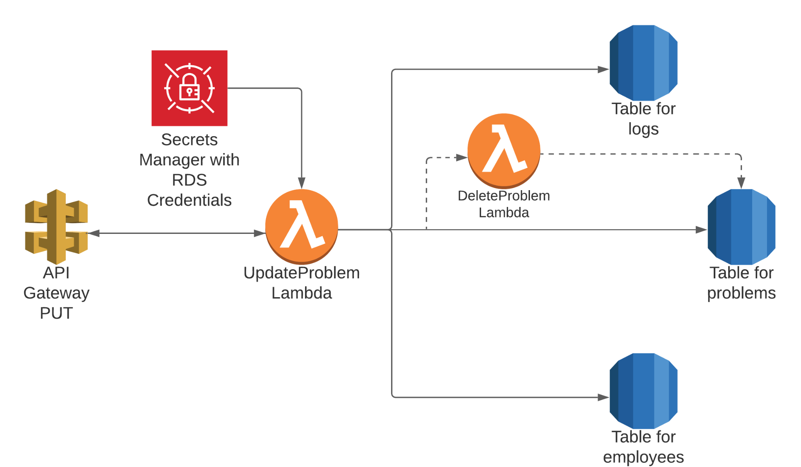
UpdateProblem

Slide 10
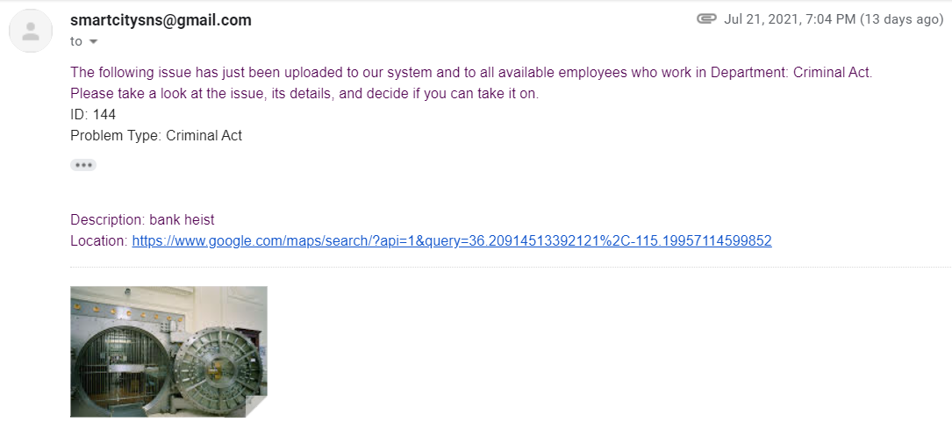
We also made a Lambda function that sends an employee an email when a new issue is reported in their department.

Slide 11
We then made an API Gateway to allow for access to our AWS system:
POST request invokes AddProblem
PUT request invokes UpdateProblem
GET request invokes ReadProblem
This will allow any web service (including our web application) to connect to our system, and also allows developers to use tools like Postman to send requests to the API.

Slide 12
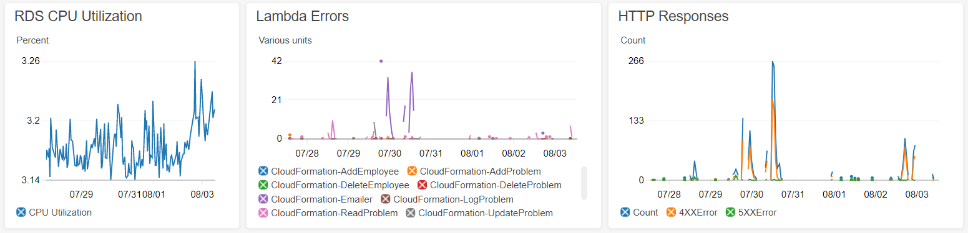
Final touch to AWS system:
We created a CloudWatch Dashboard to monitor RDS CPU Utilization, Lambda Errors, and HTTP Responses.

Slide 13
CloudFormation
We created a CloudFormation template that automatically deploys our entire system:
Creates a new database that has a dynamically generated password, and creates its tables
Builds the lambdas from .zip files that the user uploads
Creates an S3 Bucket to house user-submitted images
Sends issue reports to the email address that the user inputs as a parameter
Sets up the API Gateway, as well as its methods and lambda proxy integrations
Sets up CloudWatch logging

Slide 14
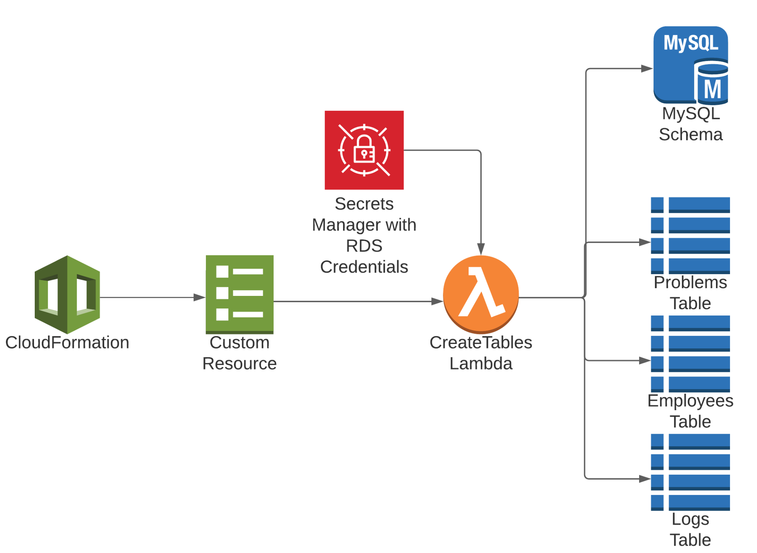
CreateTables

Slide 15
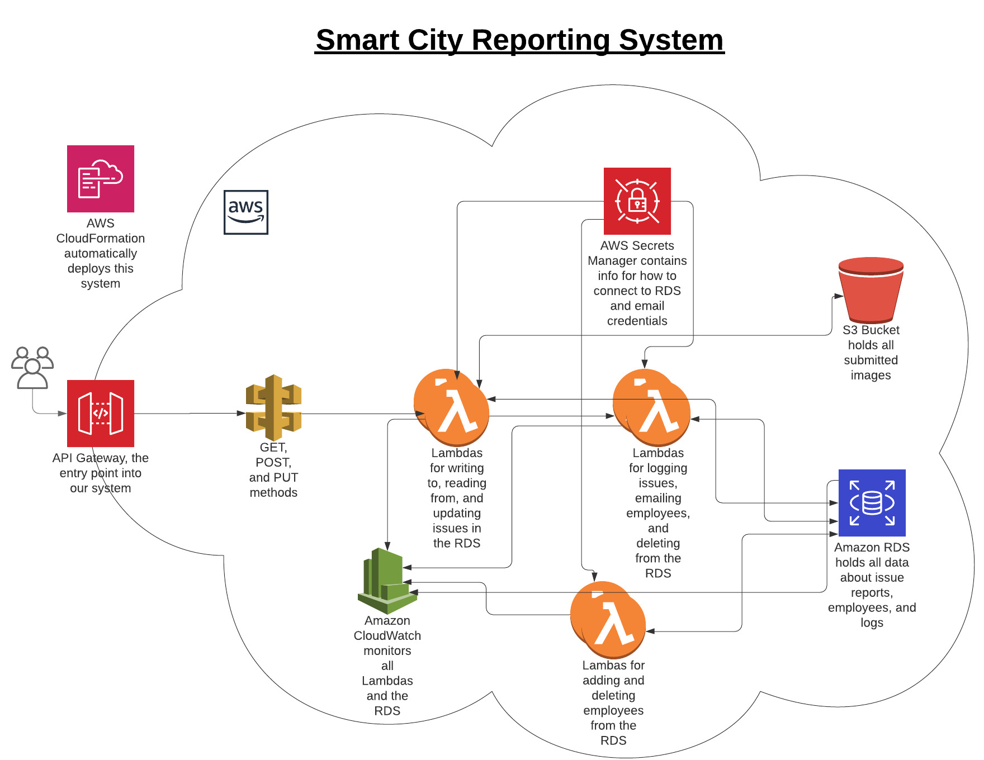

Slide 16
Front-end
To create the GUI for our system, we developed a web application using Spring Boot.
We used WebClient to connect to our API Gateway in the controller class.
We then used Docker to enable anyone to easily pull and run our application.

Slide 17
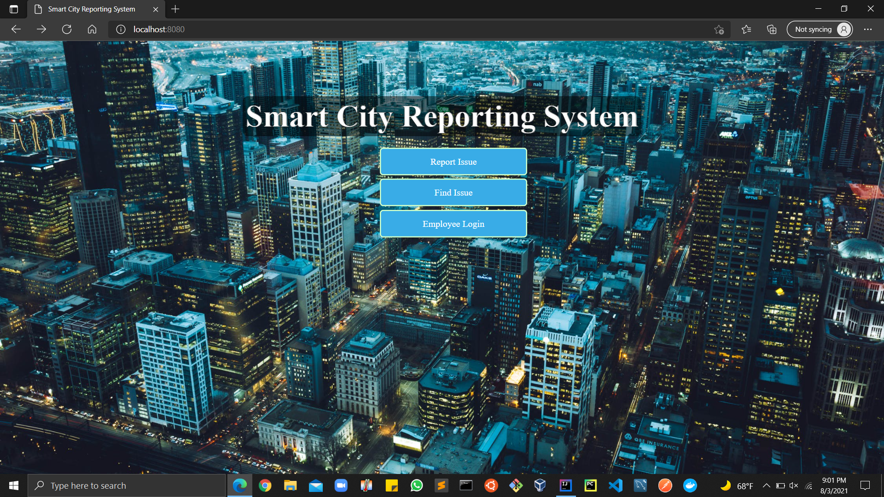
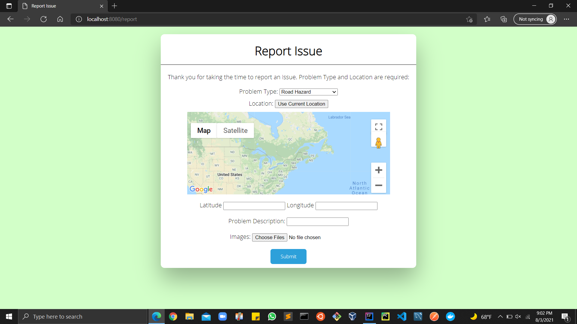
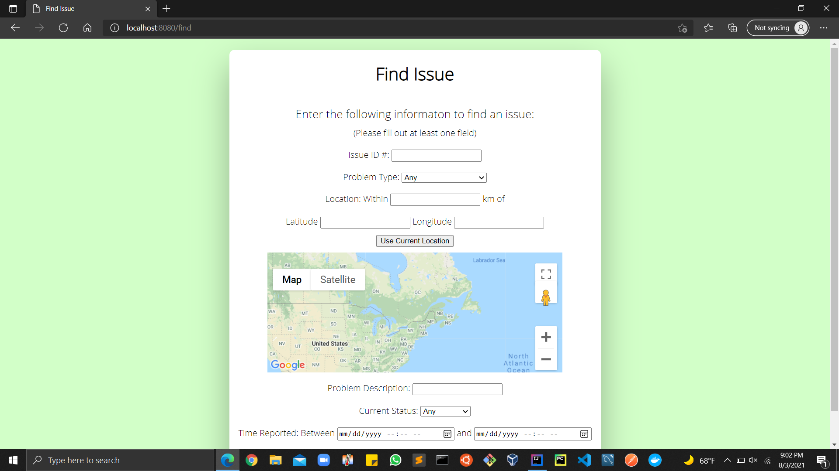
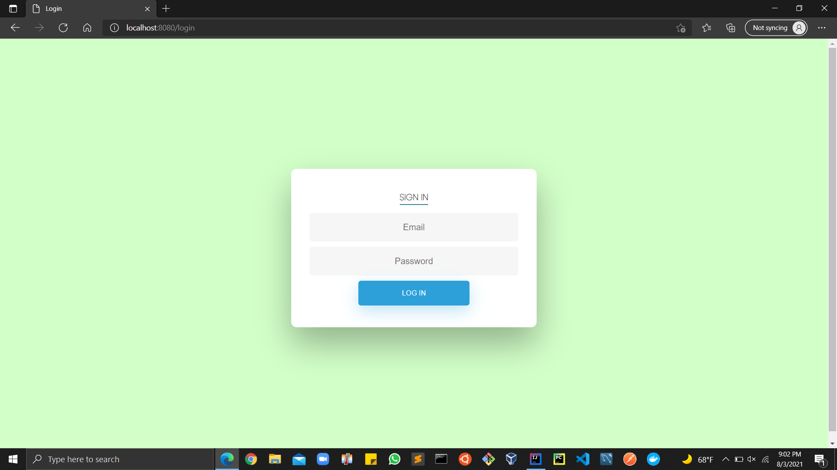

Slide 18
How to deploy (1/5):
Prerequisites:
An AWS account with appropriate permissions and sufficient credits
A Gmail account with less secure app access enabled
The Docker desktop app installed

Slide 19
How to deploy (2/5):
Create an S3 Bucket with the default settings.
Copy the name of the bucket for the next step.
Download lambdas.zip and my_sql_layer.zip and add them to the bucket.
This is only necessary because of limitations on our AWS Educate accounts. Normally, this process would be fully automated.

Slide 20
How to deploy (3/5):
Create a CloudFormation Stack with the Smart City template. Follow the instructions in the ‘Parameters’ section. Wait about ten minutes for the Stack to finish deploying.

Slide 21
How to deploy (4/5):
Open a command line and run docker run -p 8080:8080 -e API_URL=api_gateway_link -e SPRING_DATASOURCE_URL=jdbc:mysql://database_link:3306/Smart_City -e SPRING_DATASOURCE_PASSWORD="password" ecrystal/smart_city_repository:latest, but replace api_gateway_link with the Invoke URL to your API Gateway, database_link with your database hostname, and password with your database password (see below for assistance).
To find the URL to your API Gateway, visit the API Gateway Console and click SmartCityAPIGateway. On the left of the screen, click Stages. Click deployedStage. The URL next to Invoke URL is what you need.
To find the hostname and password to your database, visit the Secrets Manager Console, select MySQL-Credentials, scroll down a little and click "Retrieve secret value." You should see key-value pairs for "host" and "password."

Slide 22
How to deploy (5/5):
On your browser of choice, visit localhost:8080 and enjoy!

Slide 23
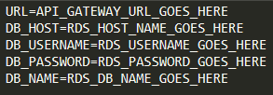
Running tests
We created tests to ensure the project is working as expected.
In order to run these tests, please follow these steps:
Download the test files then extract them
Make sure you have all the correct libraries installed by checking the requirements.txt. To install them, navigate to the test/dependencies folder and run: pip install -r requirements.txt
Create .env file in the test/resources folder to hold the environment variables for the tests. An example can be seen on the right. A template can be found in the ReadMe
Open a terminal to the test/resources folder and run: py -m pytest or python -m pytest

Slide 24
Next steps
Deploy Docker in Fargate behind API Gateway
Create management system for adding & deleting employees
Login for non-employee users
Use image recognition software to automatically report certain problems

Slide 25
See our complete GitHub repository here.

